Slide 1
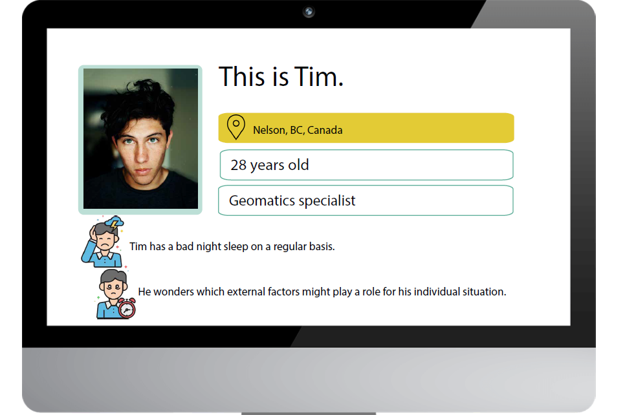

Slide 2
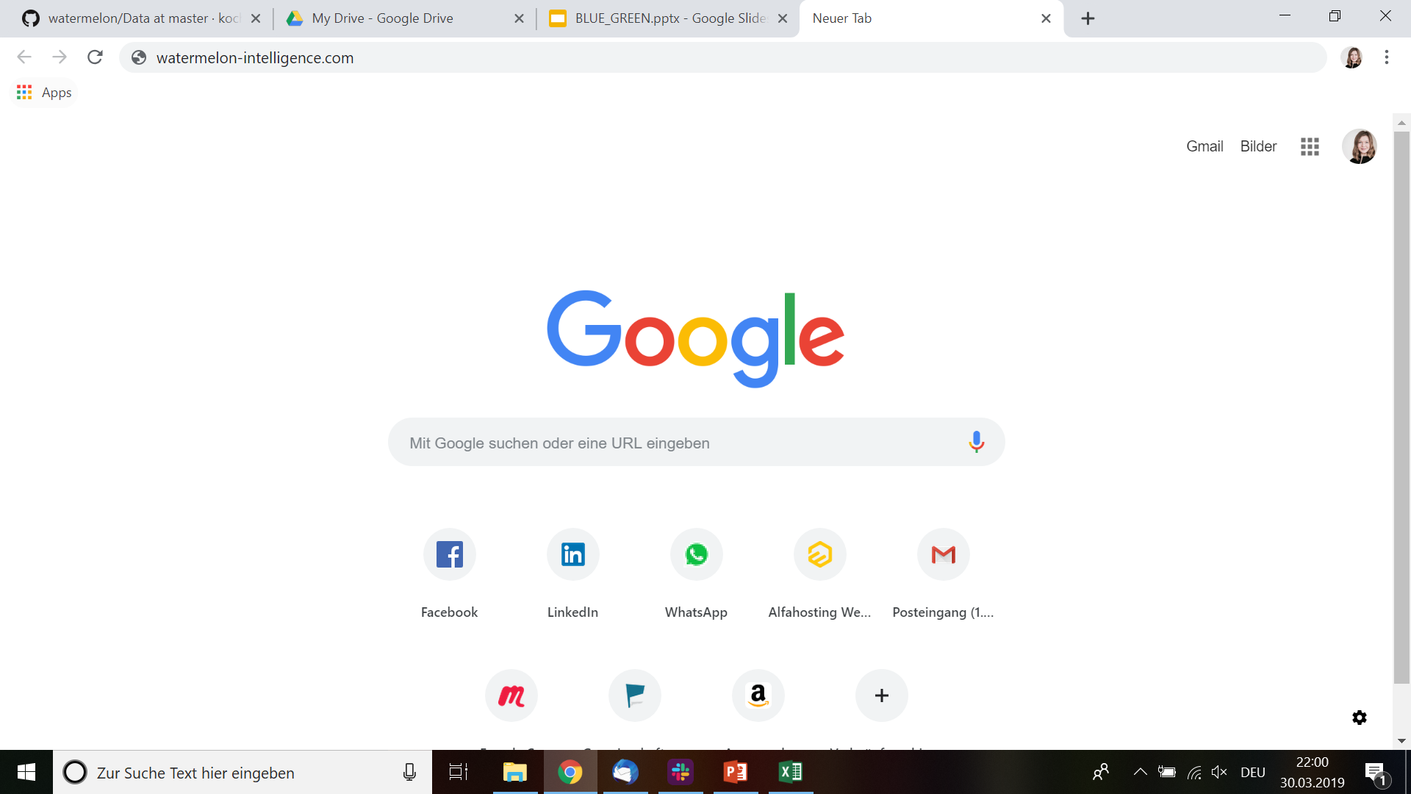

tim.steiner@gmail.com
************
Watermelon Intelligence
The digimetric you.

Slide 3
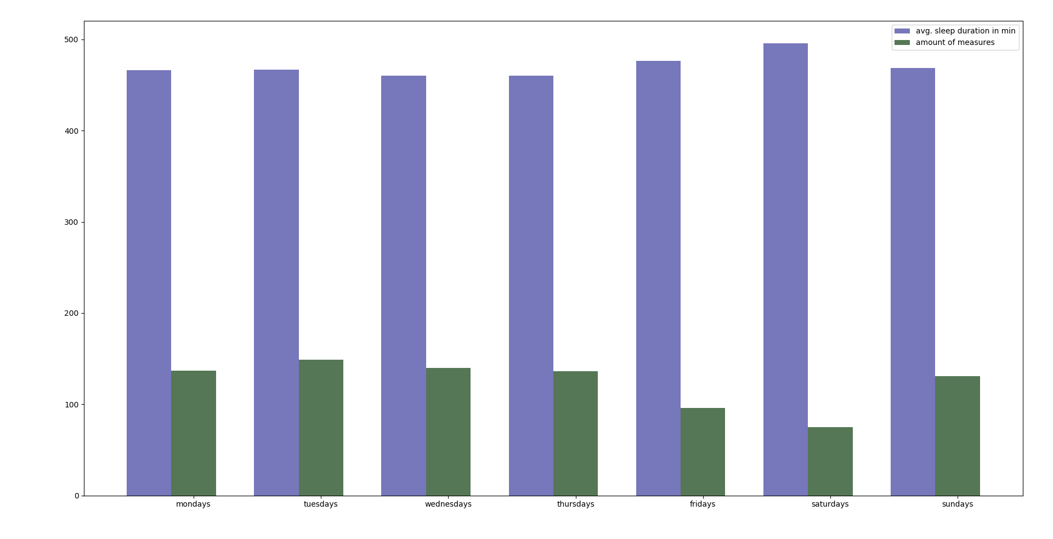
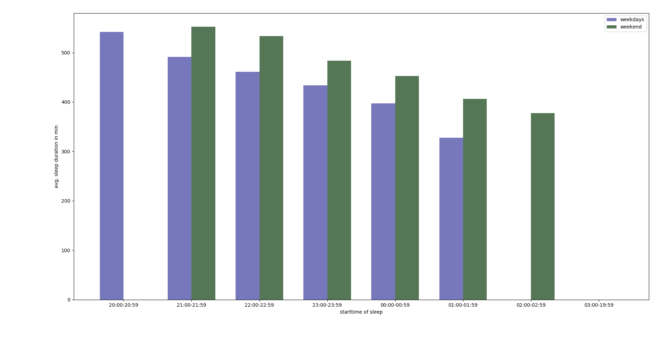
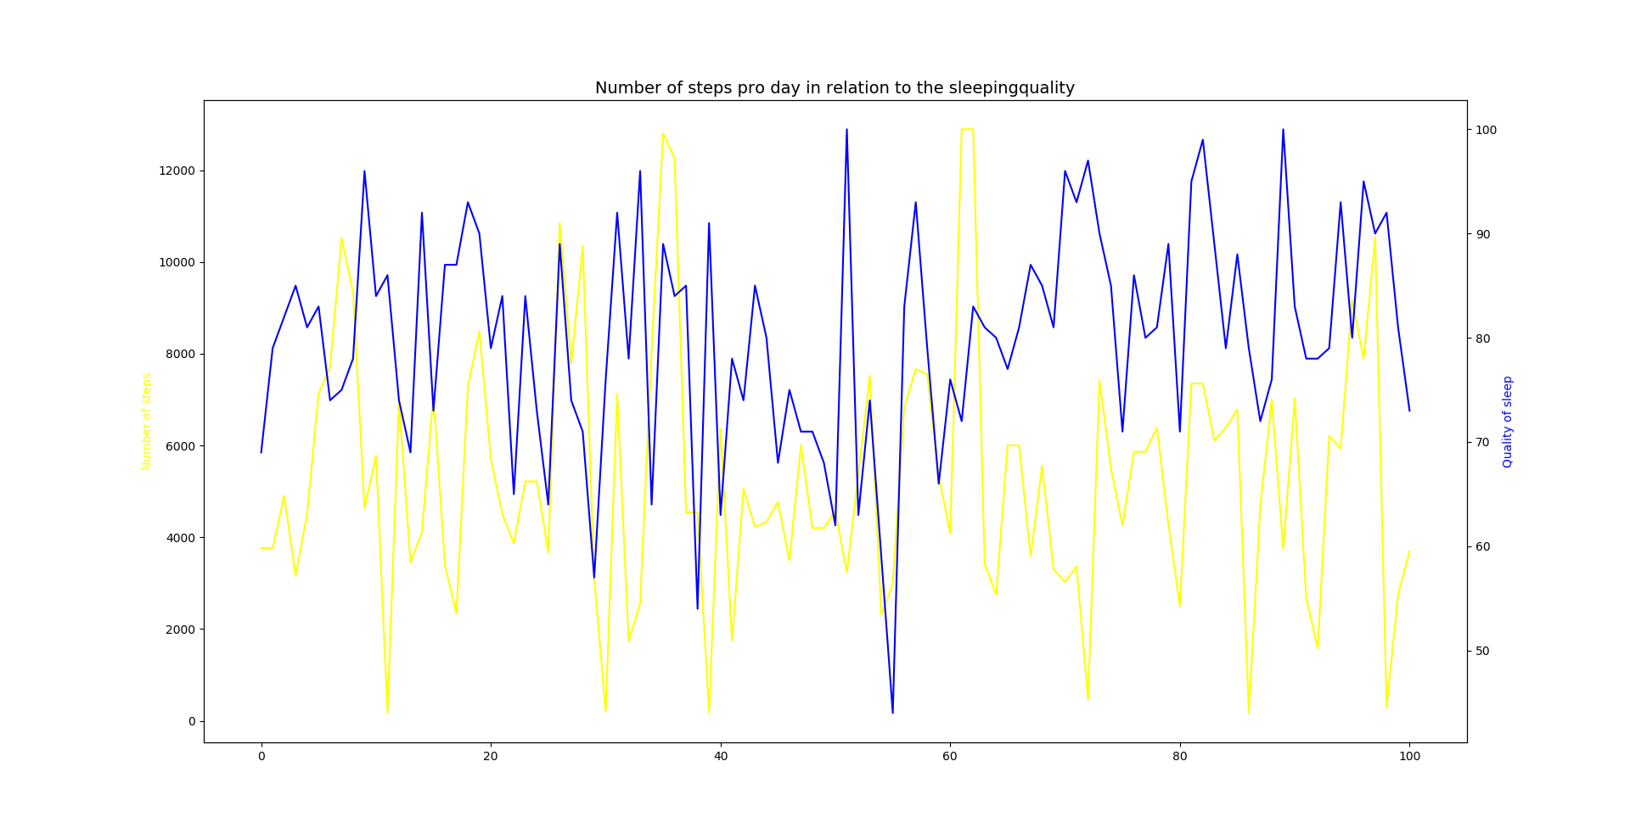
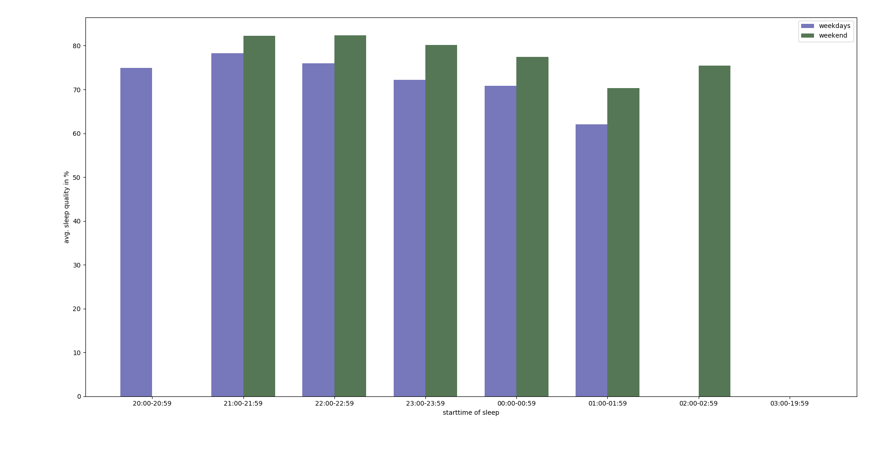
Watermelon Intelligence
tim.steiner@gmail.com
************
Self Tracking
SleepCycle
Runtastic
Activity Steps
Social
Facebook
Tinder
Instagram
Open Data
Weather
Traffic
Weekdays

Slide 4
Watermelon Intelligence
tim.steiner@gmail.com
************
Sleep Duration
Weekday
Start Time of Sleep
Personal Notes:
Longer Sleep Duration when going to bed early.

Slide 5
Watermelon Intelligence
tim.steiner@gmail.com
************
Avg. Sleep Duration in Minutes
Number of Measures/Entries
Weekday
Personal Notes:
Less entries on staurday.

Slide 6
Watermelon Intelligence
tim.steiner@gmail.com
************
Number of Steps
Entries
Quality of Sleep
Personal Notes:
No correlation.

Slide 7
Watermelon Intelligence
tim.steiner@gmail.com
************
Slepp Duration
Start Time of Sleep
Weekday
Personal Notes:
Sleep quality higher on weekends. Why?

Slide 8
MVP
Impact
Mockups of Frontend
Exemplary Analysis in Python
Providing a data driven dimension aka objective data base to answer daily life questions. Making use of data for everybody – not only companies.
Technology
Problem
Python (matplotlib, numpy)
Adobe Illustrator
Excel & Power Point
Not having all the data in one place for a holistic analysis.

